Slide 1
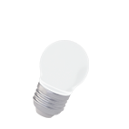
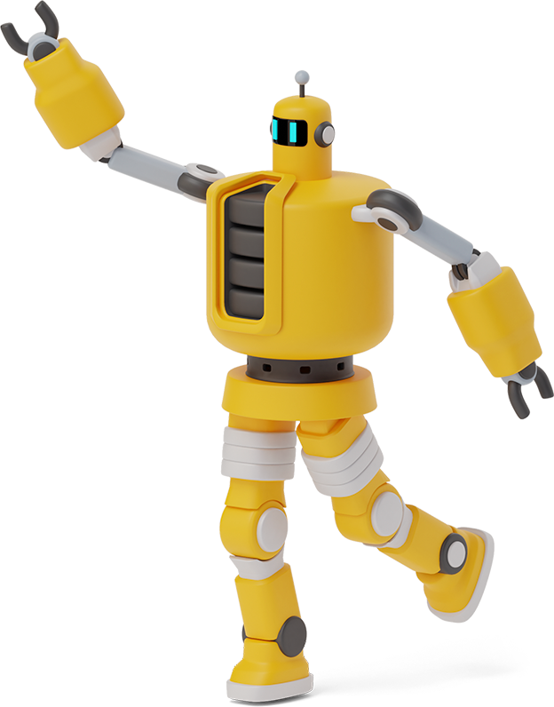
Python Playground

Slide 2
Roadmap
Homework Link
Variable Examples
Class Activity
1
3
5
2
4
6
Review Of Past Class & HW Questions
Input Function
Introduction to Functions

Slide 3
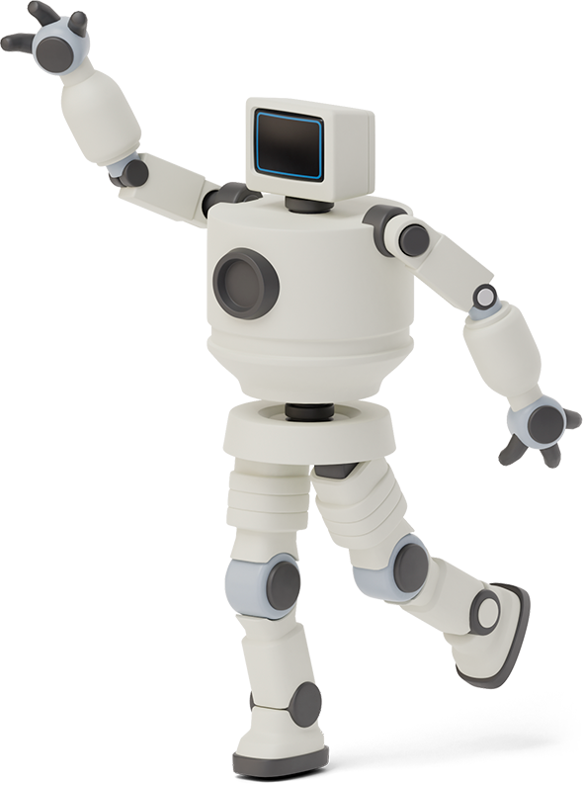

Homework Link
https://github.com/Asfandyar-Khan/PythonPlayground/blob/main/index.md
Contains all lectures and Google Colab notebooks
Contains homework which will be a word document

Slide 4
Review of Last Week
Integer vs. Float Division
Expressions vs. Statements
What is a variable?
How do we use variables?
type() function
int() function
float() function
Let’s review the homework!

Slide 5
Let’s look at Variables a little closer!

Slide 6
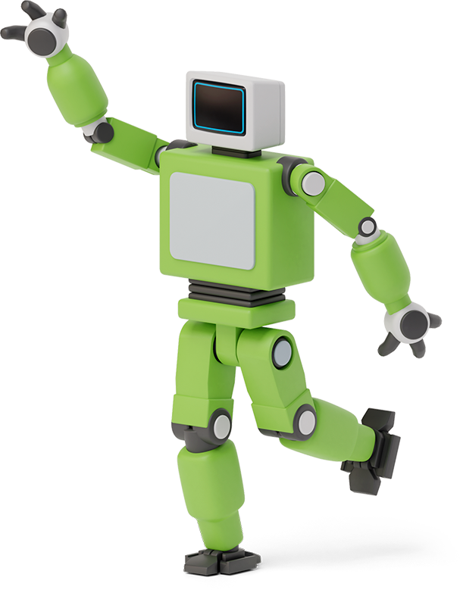

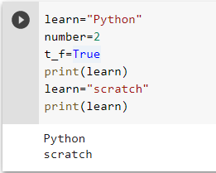
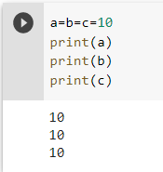
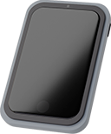
Using variables in python
Assignment operator (=) is used to assign a value to a variable.

Slide 7

Recall Variables!
A Python variable is a name that equals to a value
For example: A = 10 or B = “Hello”
Variables cannot begin with a number
Variables are lower-case only
Variables can be both letters and numbers
For Example: n1 = 10 or fruit_1 = “Apple”

Slide 8
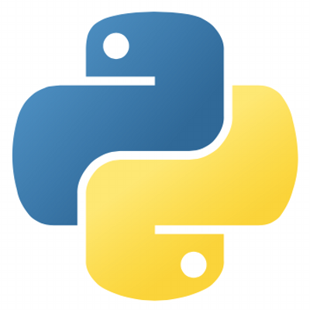
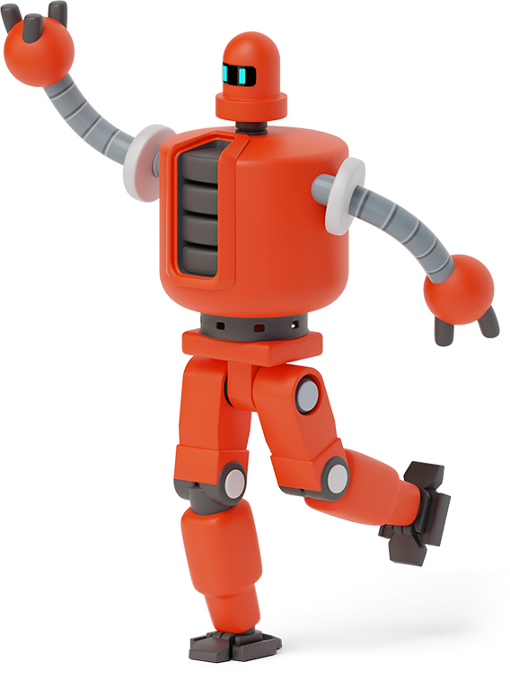
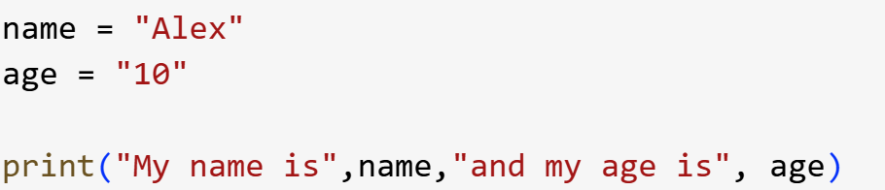
Knowledge Check!
Create a variable that contains your name as a string
Create a variable that contains your age
Print out a sentence that tells you your name and then tells you your age
Can we comebine these variables together in one print statement?

Slide 9
Input Function
Input()
This function allows us to take input from a user and store it in a variable!
Syntax:
input_variable = input(argument 1)

Slide 10
Input Function, continued
name = input('Enter your name =')
age = input('Enter your age = ')
print('Your name is ', name )
print('Your age is ', age )
Can we do this on one line instead of two?

Slide 11

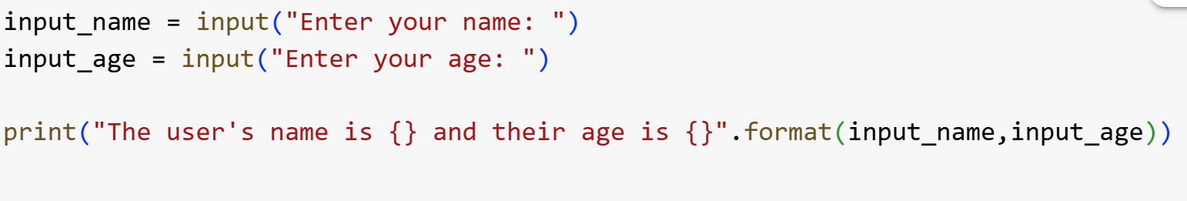
Class Activity
Create a python program using the input() function that asks users for their name, their age, and how many pets they have
Print out these results on a single line of code if you can

Slide 12
What is a Function?
A function is a set of statements that run when the function is called
Python has many built in functions!
print(), type(), int(), float(), str(), round()
What if we want to build our own functions?
WE CAN!

Slide 13
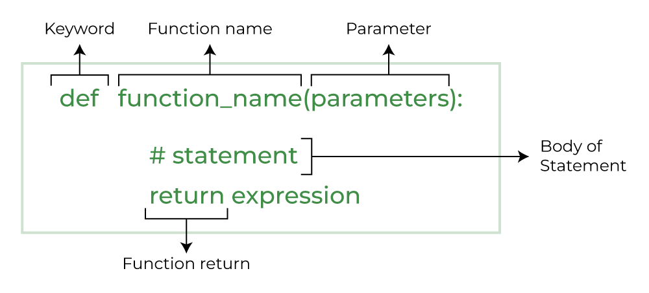
What is a Function?

Slide 14

Class Activity
Create a function that prints out your favourite food!
Everytime this function is called, your favourite food is going to be printed as text in the Python editor

Slide 15
Thanks!
Any questions?

